Slide 1

City of Springfield
FY15 Mayor’s Recommended Budget
May 19, 2014

Slide 2
Agenda
FY15 Projected Budget Gap
Levy Ceiling Growth
State Support
Revenue Increases
Spending Reductions
FY15 Initiatives

Slide 3
FY15 Projected Budget Gap
MYFP Deficit= $17.03 million
  Revenue Assumptions Level from State and Taxes
  Expense Assumptions include growth of 2.5%
  One Time Revenue from FY14 not included ($10M)
Department Requests grew gap to $21.7 million including

Slide 4
Decisions Used to Balance

Slide 5
Tax Levy –
Ceiling Growth

Slide 6
State Support
The 2 main categories that make up the majority of State Aid are:
  Chapter 70 – Funding for the School Department allocated formulaically by the State
  Unrestricted General Government Aid (UGGA) – Our most flexible State funding that supports City Department operations
Based on the Joint Resolution passed by the House and Senate the City will benefit from
  Level funding for C.70 which is the same as the Governor filed.
  2.77% increase for UGGA which is $908 thousand more than the Governor filed.

Slide 7
Revenue Increases
Grow Levy Ceiling - $4,323,924
Less Overlay Appropriation than last year - $2,000,00
Additional State Aid over FY14- $908,976
Expected increase in number of building permits - $500,000
  Penalties and Interest on Taxes - $300,000
Auction Revenue- $300,000
  Penalties and Interest on Tax Title Property- $250,000
Fire Inspection Fees - $200,000
Business Entertainment Fees - $145,000

Slide 8
Spending Reductions– All Departments
Strategically reduced budget based on historical spending- $1,412,511
Offset salaries to grants - $635,004
Debt Schedule Reduction - $2,668,864
School Department Assistance
  Quebec Team - $1,719,807
  Indirect Cost Rate on School Grants - $1,050,000
  School Transportation - $1,058,164
  McKinney Vento Transportation Reimbursement - $900,000
Pay-Go
  Use unexpended pay-go funds - $ 1,083,419
  Use of WMECO Settlement - $1,334,560

Slide 9
Spending Reductions– All Departments
Use Enterprise Fund Retained Earnings from FY13 to offset General Fund Appropriation - $200,000
Reduction in Health Insurance from lower than expected rates - $851,657
Less Reserves for Contingency - $50,000
Strategically Manage Hiring for Increased Vacancy Savings - $200,000

Slide 10
One – Time Revenue
Stab Reserves History
  Trending toward using less reserves to balance the budget
  Keeping balance over $30M
  Reinforces commitment to financial policies with Rating Agencies, business community and our residents
Building Sales - $2.2M
WMECO Settlement - $1.3M

Slide 11
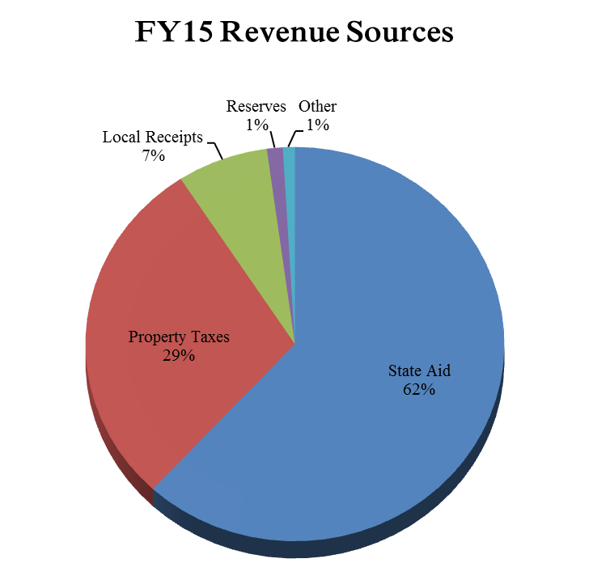

Slide 12
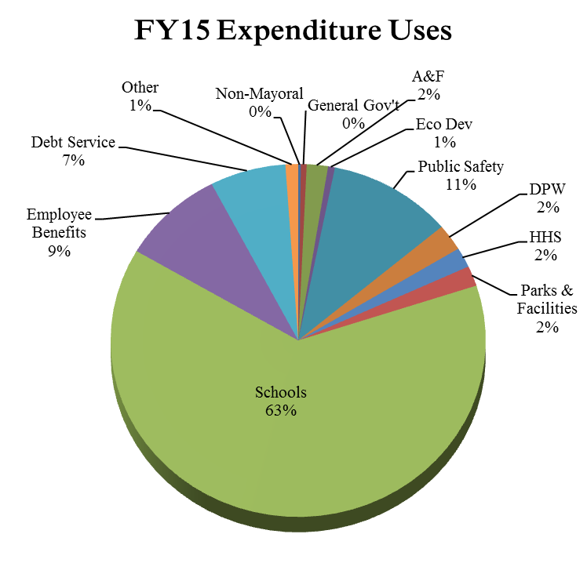

Slide 14
What the Budget Buys
Police-
  A fully funded Police Academy recruit class of 26 and mini-academy of 6-12 in FY15
  14 new positions including 7 officers, 3 cadets, 3 record clerks and a senior crime analyst
  Continue its highly ranked deployment strategies such as the C3 - Initiative, Operation BADGE and the Ordinance/Flex Squad
  The shot-spotter system which detects gun shots covering six square miles continues to be funded to help react to crime.
  Additional funding for police professional development
Fire-
  20 new positions trained in two separate academies in the fall and spring
  Upgrades to Telestaff for greater scheduling efficiency
  New computers in Fire Houses
  A multi-lingual educational program leveraged through the Rolf H. Jensen Memorial Public Education Grant. This is only granted to one department in the country each year.
  A fully funded staff to respond to over 16,000 calls saving an average of $18 million of property damage each year
  Appropriately fund and replace turnout gear replacement and continue training in every effort to ensure firefighter safety.

Slide 15
What the Budget Buys
Capital Asset Construction –
  Two new project managers have been added to bring costly project management costs in-house enlisting tighter controls on contract compliance and timely reimbursements from funding agencies
DPW –
  The Solid Waste Division will continue to provide curb-side Single Stream Recycling pick-up, curb-side Yard Waste pick-up, Low Cost Bulk curb-side pick-up, and some Hazardous Waste Days – all at a very low annual cost to residents.
  Upgrades to Cartegraph and new computer tablets
  Five year lease for four new trash trucks
Parks and Recreation-
  Summer recreation programs are intact, including fully-staffed golf courses
  City pools, 5-mile Pond and all splash pads will be open during summer months
  Terraces will be maintained across the City using the most cost effective labor available including Sheriff’s Crews.
  Zamboni lease and new golf maintenance equipment

Slide 16
What the Budget Buys
Libraries –
  Continued 30 hour schedule at all branches
  Programming and outreach teams to address important Springfield issues and populations. These include Adult Literacy and Lifelong Learning, After School, Civic and Community Engagement, Early Literacy and Workforce Development.
Health and Human Service Division-
  Fully –staffed Nursing staff, Community Health Advocates, Public Health Educators and Mediators to determine the health and human services needs of residents
Department of Planning and Economic Development-
  Fully-staffed to continue all development and recovery activities that will move the City forward.
City Council/ Clerk –
  A staff position has been added to assist with the current staff’s workload and scheduling conflicts
  Software updates for efficient ordinance updates and fee tracking

