Slide 1

October 12th – 18th
City of Springfield
Confirmed COVID-19 Cases by Age and Zip Code

Slide 2
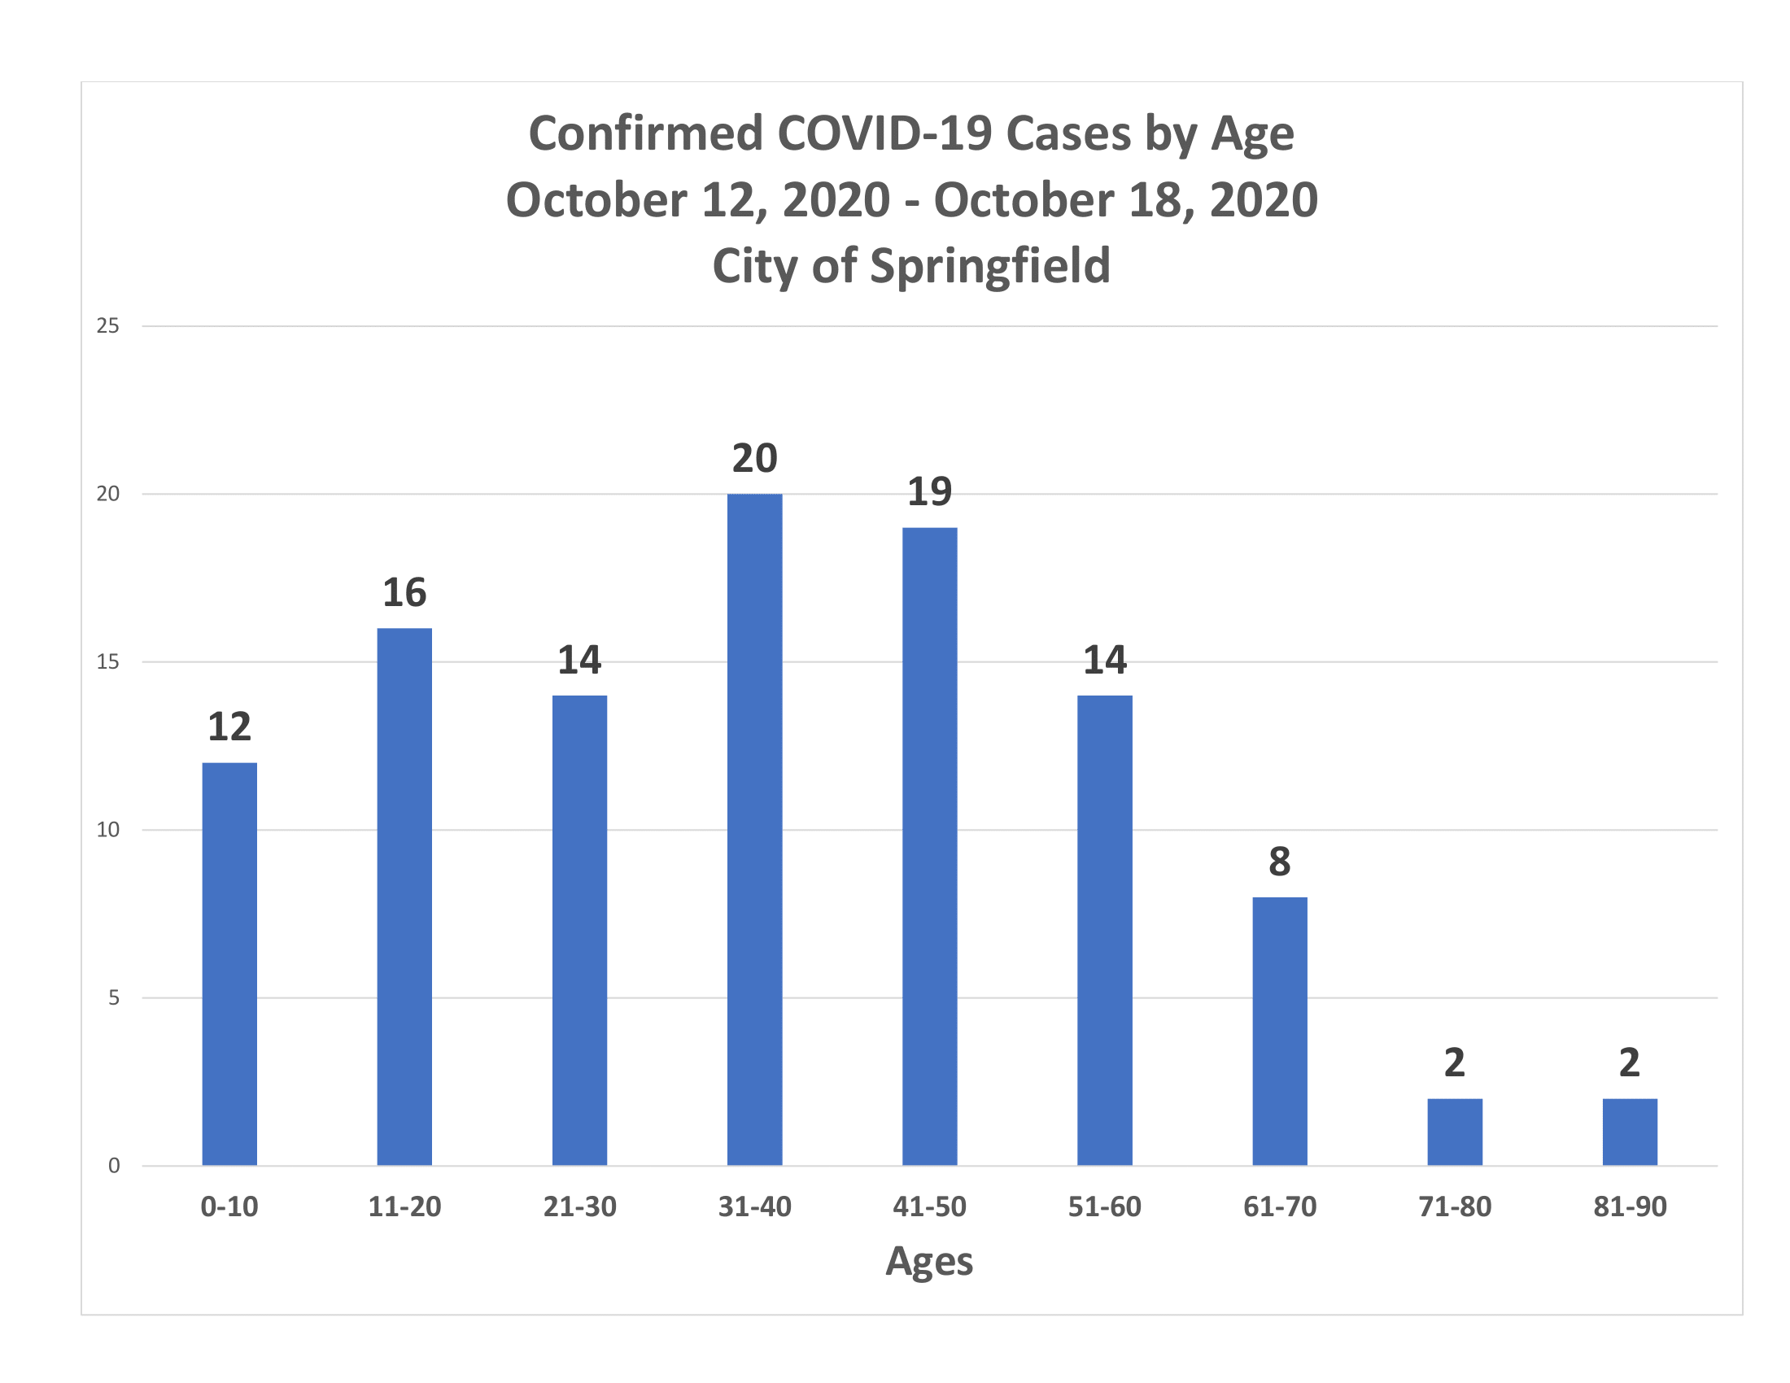

Slide 3
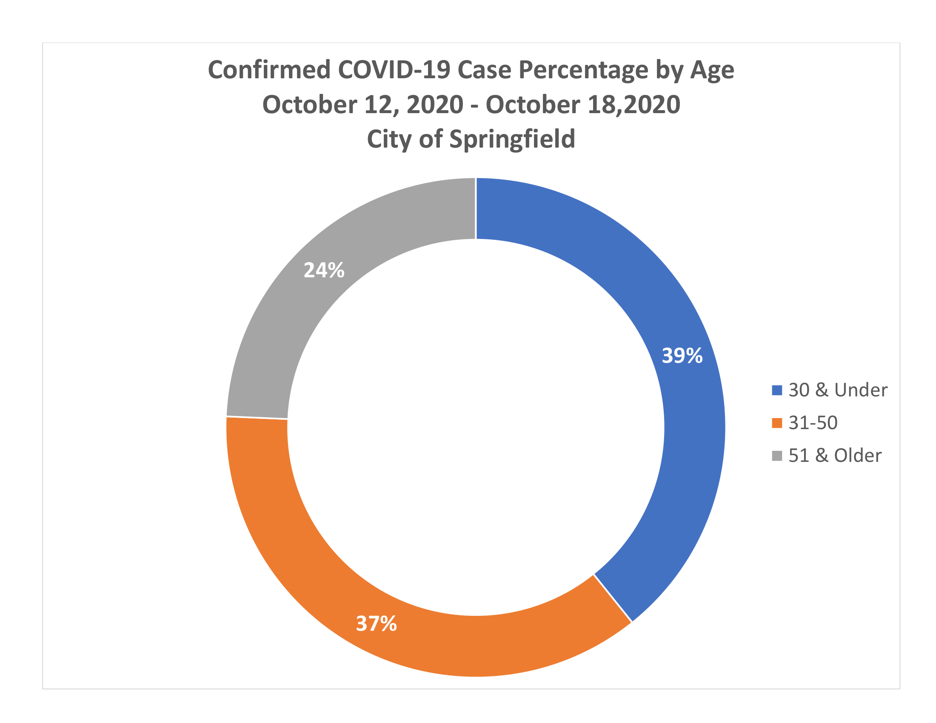

Slide 4
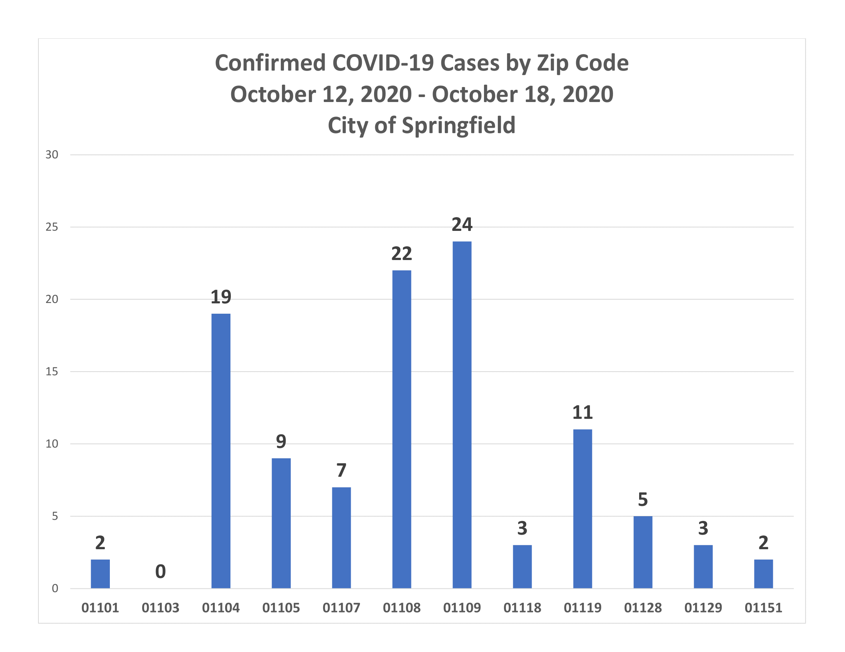

Slide 5
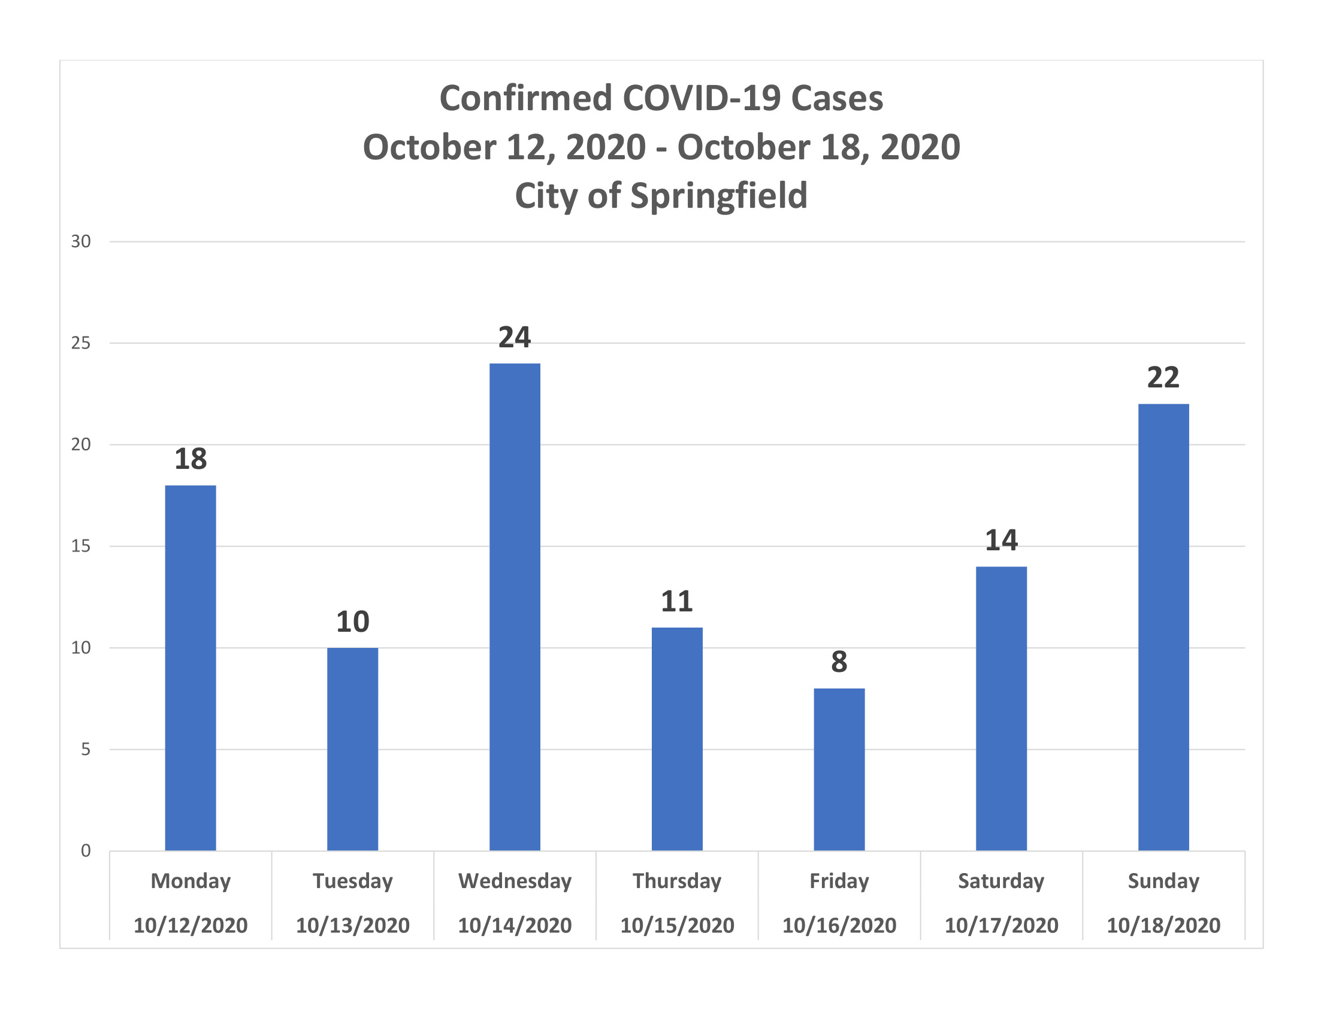

Slide 6
