Slide 1
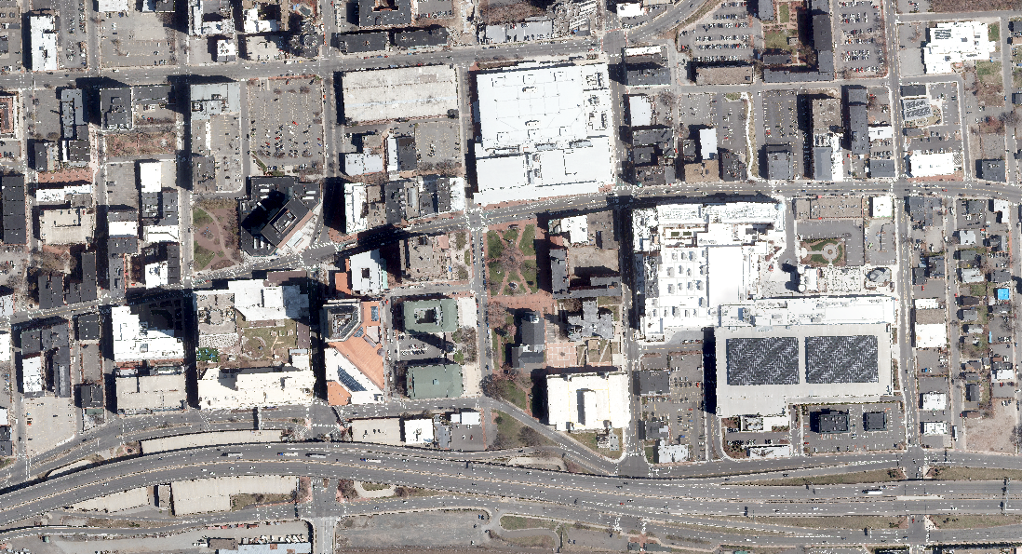
Downtown Springfield Traffic Management Plan
Dwight St.
Parking Locations
TD Bank – Harrison Ave.
Dwight St.
Main St.
Union Station
Tower Sq.
State St.
Union St.
Monarch Pl.
MGM
Hamden St.
E. Columbus
I-91 North
W. Columbus
I-91 South

Slide 2
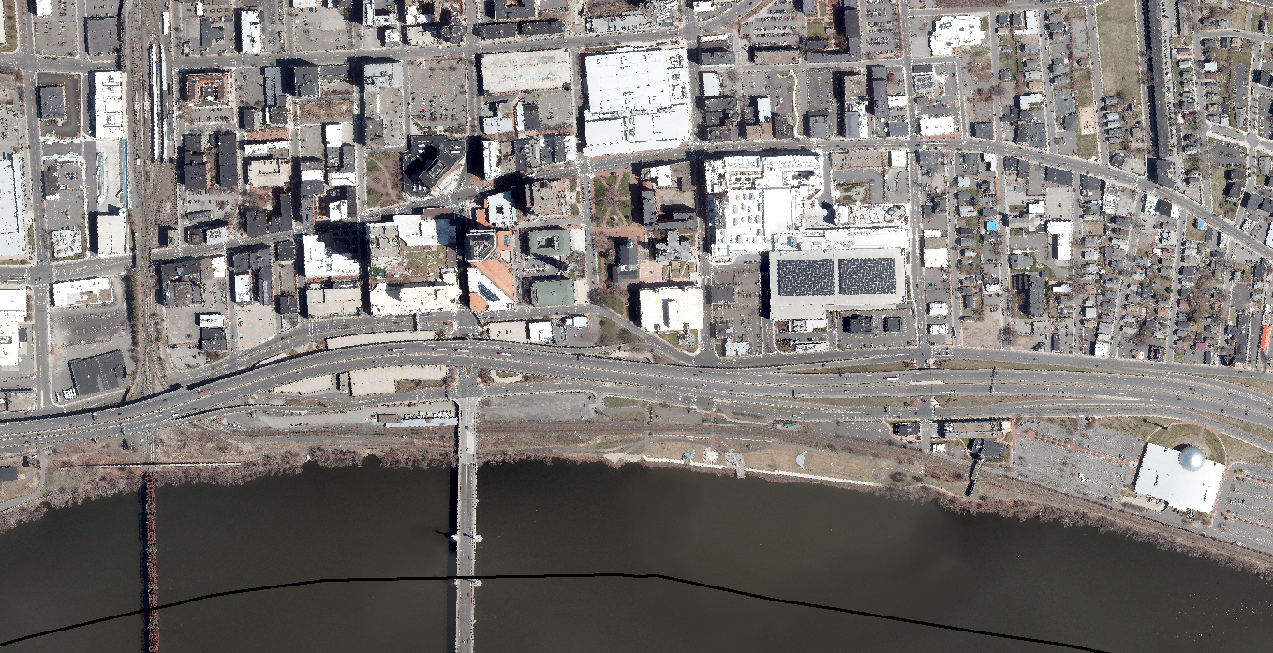
Road Closure Plan
Full Closure
Partial Closure
Dwight St.
Main St.
State St.
Union St.
MGM
E. Columbus
State St.
W. Columbus
W. Columbus
E. Columbus & Union
W. Columbus & State St.

Slide 3
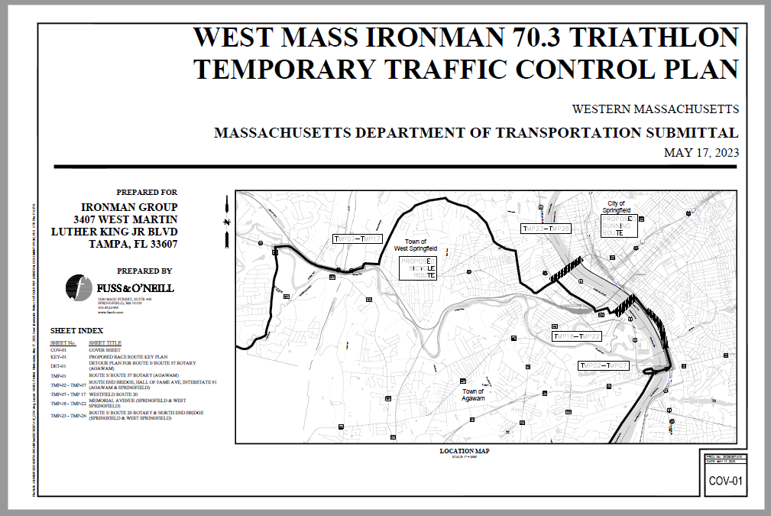
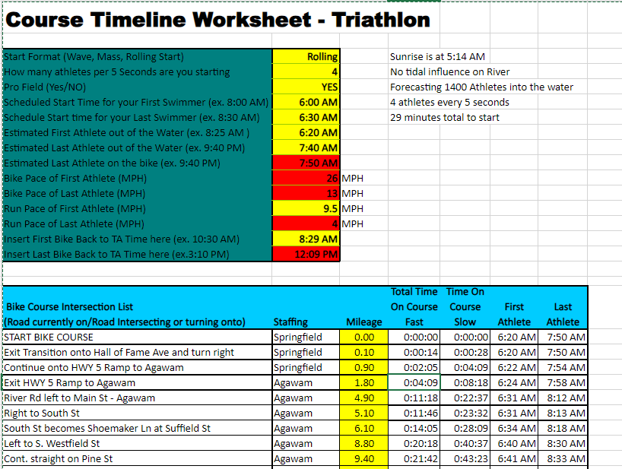
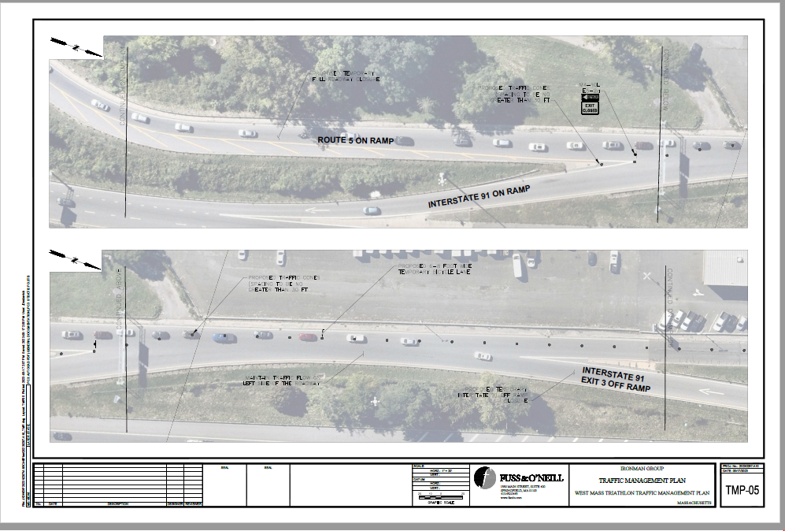
Road Closure Plan

