Slide 1
City of Springfield
Department of Health and Human Services
Neighborhood Council COVID-19 Update
October 14, 2020

Slide 3
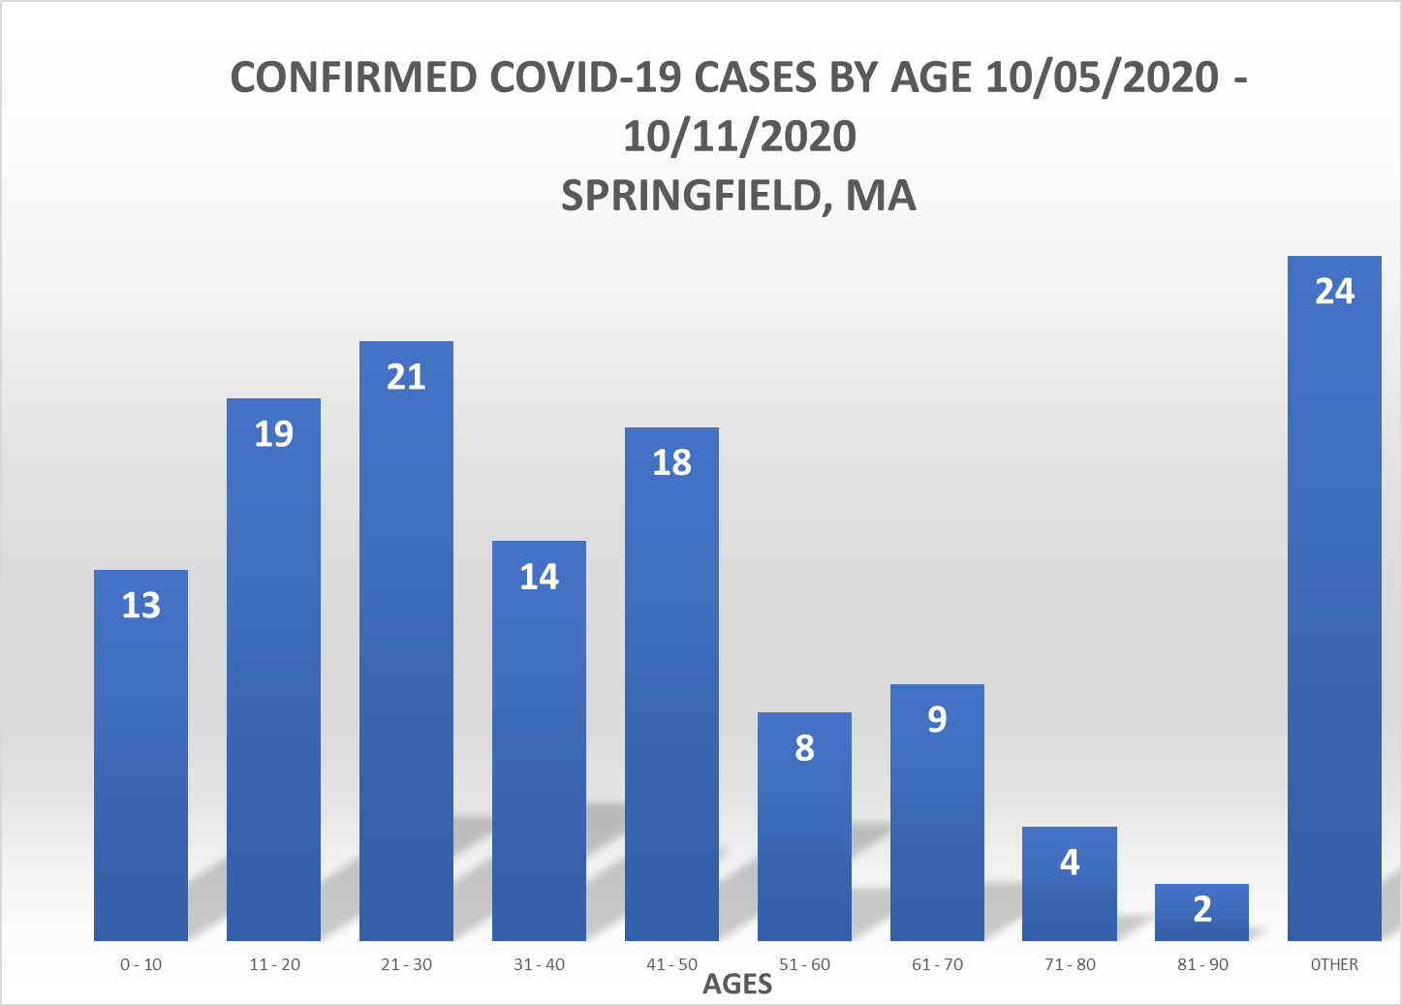

Slide 6
